Slide 1

Unit-II
MGN-502
HRM - Staffing
p. b. Narendra Kiran
Assistant professor

Slide 2
Staffing
Learning outcome-
be able to explain the importance of staffing in HRM

Slide 3
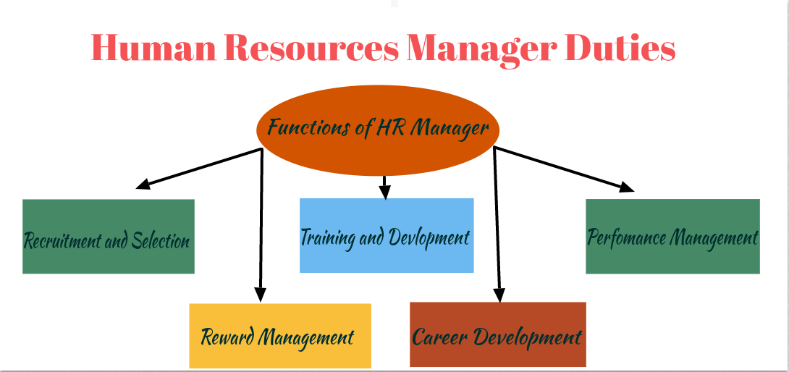
Functions of HRM

Slide 4
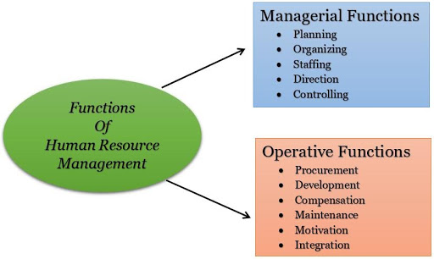

Slide 5
Staffing
HRM: Human Resource Management is the strategic approach to the effective management of people in a company or organization such that they help their business gain a competitive advantage.

Slide 6
Objective of Staffing
To understand all functions in an organisation
To understand manpower planning so that people are available at right time and at a right place
To understand issues related job analysis and to overcome the problem

Slide 7
Functions of Staffing
The first and foremost function of staffing is to obtain qualified personnel for different jobs position in the organization.
In staffing, the right person is recruited for the right jobs, therefore it leads to maximum productivity and higher performance.
It helps in promoting the optimum utilization of human resource through various aspects.
Job satisfaction and morale of the workers increases through the recruitment of the right person.
Staffing helps to ensure better utilization of human resources.
It ensures the continuity and growth of the organization, through development managers

Slide 8
Importance of Staffing
Efficient performance of other functions
Effective use of technology and other resources
Optimum utilization of human resources
Development of Human capital
The motivation of Human resources
Building higher morale

Slide 9
Staffing Process
3 Parts : Recruitment, Selection and Hiring
Recruiting : The process of attracting qualified applicants
Selecting : The process of screening applicants and narrowing the job pool
Hiring : The process of extending offers to the most desirable applicants

Slide 10
Eight Steps in the Staffing Process
Human Resource Planning
Recruitment
Selection
Induction and Orientation
Training and Development
Performance Appraisal
Transfers
Separations

Slide 11
Elements of Staffing
Manpower Planning
Job Analysis
Recruitment and Selection
Training and Development
Performance Appraisal

Slide 12
SELECTION
Selection is the process of choosing most suitable person for specific job role who can successfully deliver valuable contributions to the organization.
It is a negative function of HRM as it involves rejection.

Slide 13
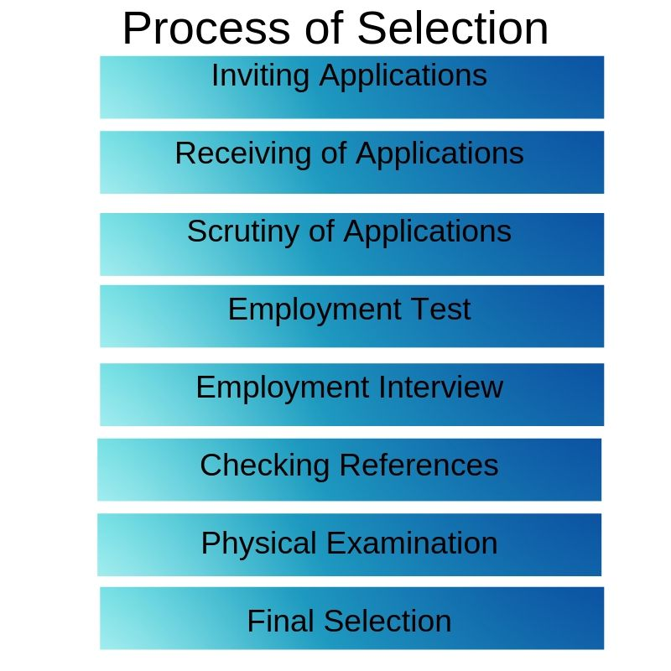

Slide 14
Conclusion
Staffing is the most vital asset with an organization, without which it cannot move ahead in the competitive world.
It can be equated with HR management as both have same sort of objectives.
Staffing is an open system approach.
It is carried out within the enterprise but it is also linked to external environment.

